Slide 1
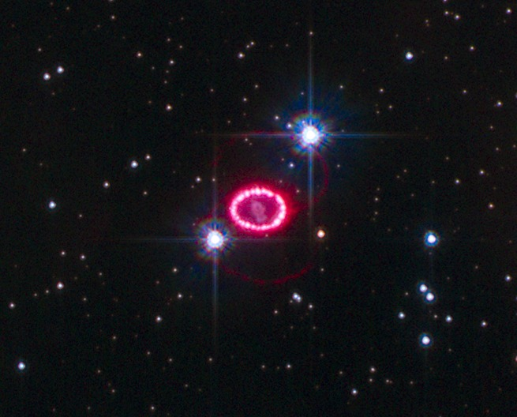
The Origins of Elements
"The nitrogen in our DNA, the calcium in our teeth, the iron in our blood, the carbon in our apple pies were made in the interiors of collapsing stars. We are made of star stuff.“
—Carl Sagan

Slide 2
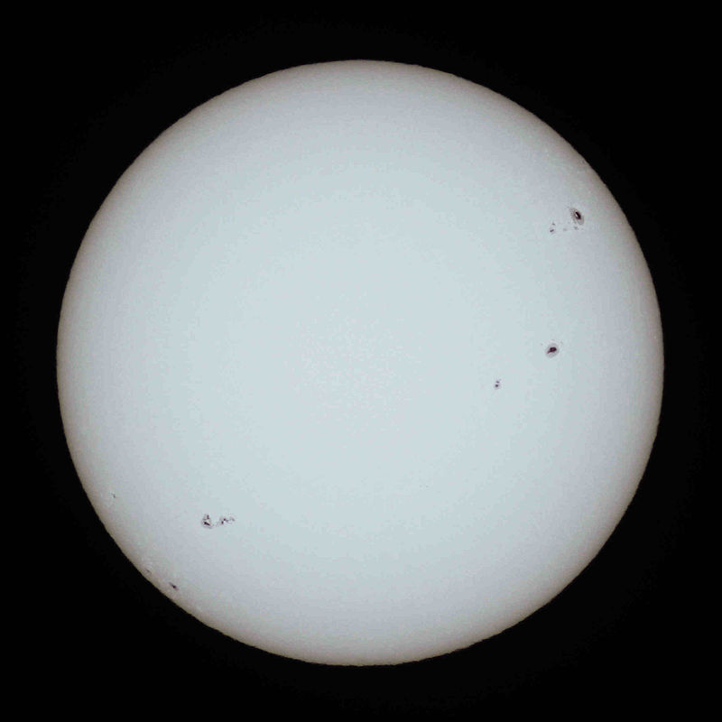
Sol – Our Sun
Our sun is a low mass, main sequence star.
Throughout most of its life, a star produces helium from hydrogen fusion.
“Main Sequence” refers to this hydrogen fusion stage of a star’s life
Fusion reactions also produce enormous amounts of energy.
http://www.popastro.com/solar/solarobserving/chapter.php?id_pag=30

Slide 3
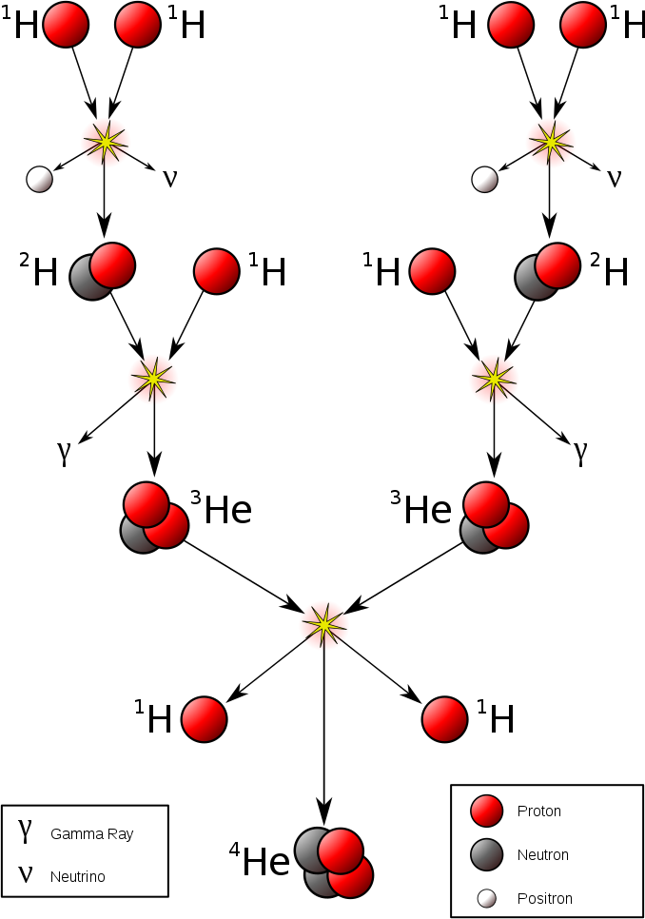
The Hydrogen Fusion Reaction
The helium producing reaction characteristic of main sequence stars, such as our sun.
Commons.Wikimedia.Org/wiki/user:Borb

Slide 4
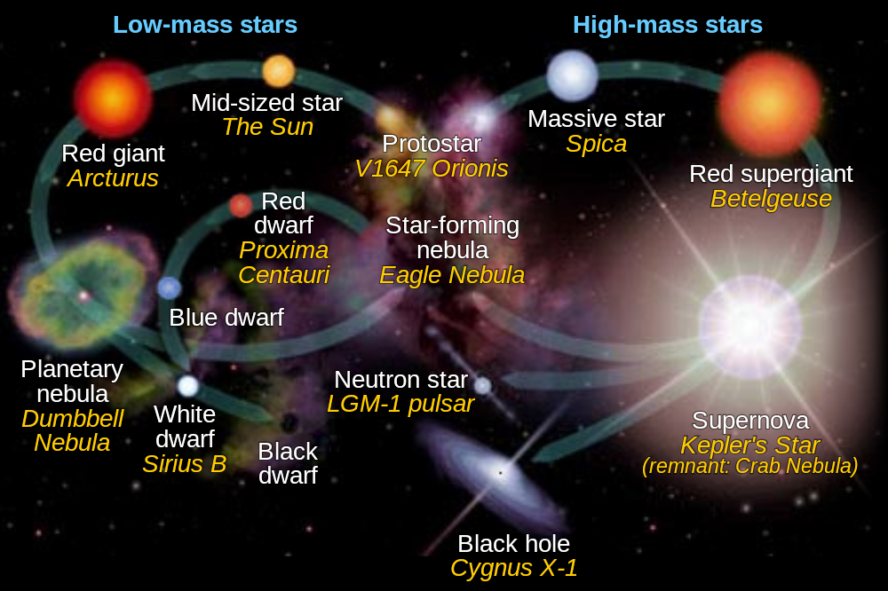
Life Cycle of Stars

Slide 5
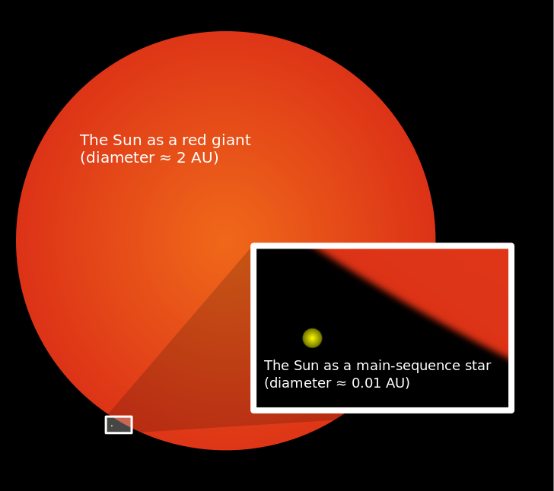
The Sun’s Future
The sun will not go “supernova” – it is not large enough
Our sun will become a red giant in about 5 billion years
It will swallow Mercury, Venus and Earth
Commons.Wikimedia.org/wiki/User:Mysid

Slide 6
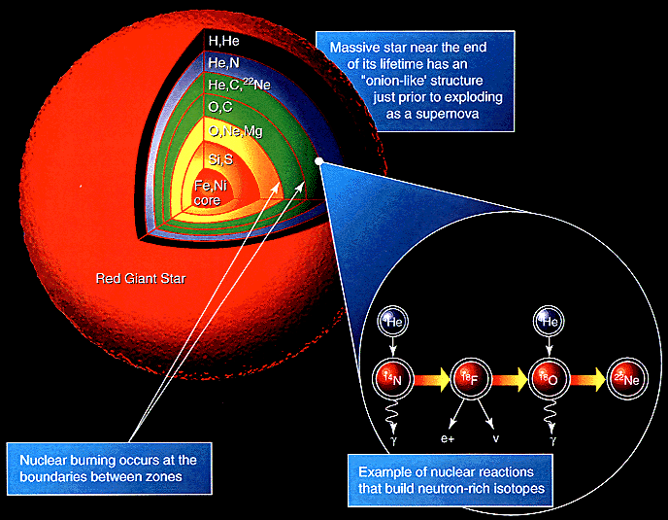
Nucleosynthesis in a Red Giant Star

Slide 7
The C-N-O Cycle
$${}_{6}^{12}{C + {}_{1}^{1}{H → {}_{7}^{13}{N+ γ + 1.95 MeV}}}$$
$${}_{7}^{13}{N → {}_{6}^{13}{C + {}_{1}^{0}{e + 1.20 MeV}}}$$
$${}_{6}^{13}{C + {}_{1}^{1}{H → {}_{7}^{14}{N + γ + 7.54 MeV}}}$$
$${}_{7}^{14}{N + {}_{1}^{1}{H → {}_{8}^{15}{O + γ + 7.35 MeV}}}$$
$${}_{8}^{15}{O → {}_{7}^{15}{N + {}_{1}^{0}{e + 1.73 MeV}}}$$
$${}_{7}^{15}{N + {}_{1}^{1}{H → {}_{6}^{12}{C + {}_{2}^{4}{He + 4.96 MeV}}}}$$

Slide 8








The silicon-burning sequence in the core of a contracting massive star
$${}_{14}^{28}{Si + {}_{2}^{4}{He → {}_{16}^{32}S}}$$
$${}_{16}^{32}{S + {}_{2}^{4}{He → {}_{18}^{36}{Ar}}}$$
$${}_{18}^{36}{Ar + {}_{2}^{4}{He → {}_{20}^{40}{Ca}}}$$
$${}_{20}^{40}{Ca + {}_{2}^{4}{He → {}_{22}^{44}{Ti}}}$$
$${}_{22}^{44}{Ti + {}_{2}^{4}{He → {}_{24}^{48}{Cr}}}$$
$${}_{24}^{48}{Cr + {}_{2}^{4}{He → {}_{26}^{52}{Fe}}}$$
$${}_{26}^{52}{Fe + {}_{2}^{4}{He → {}_{28}^{56}{Ni}}}$$
$${}_{28}^{56}{Ni + {}_{2}^{4}{He → {}_{30}^{60}{Zn}}}$$

Slide 9
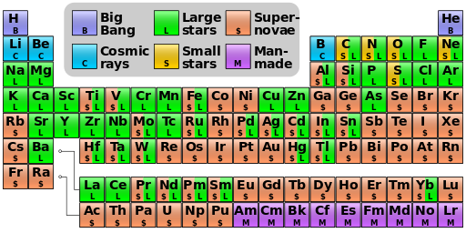
Nucleosynthesis Periodic Table
Commons.Wikimedia.Org/wiki/user:Cmglee

